Slide 1
SoA – ExpressRoute Architectures

Slide 2
SoA ExpressRoute Summary
Skytap Integrated ExpressRoute Circuit
Standard ExpressRoute SKU; Global Reach Not Supported
Created using the Skytap Portal
ExR Circuit provided at no additional cost to customer⁽¹⁾
Customer ExpressRoute Circuit
Created in the Azure Portal in the customer’s subscription
Connected to a Skytap WAN via the Skytap Portal
Additional cost invoiced by Microsoft
Azure geopolitical regions: https://docs.microsoft.com/en-us/azure/expressroute/expressroute-locations#locations
Scenario | Skytap Integrated ExR Circuit | Customer ExR Circuit | Notes
1. Skytap SDN <-> Azure VNet using VNet ER Gateway: Same Region | X | X
2. Skytap SDN <-> Azure VNet using VNet ER Gateway: Different Region/Same Geopolitical Region | X | X
3. Skytap SDN <-> Azure Vnet using Vnet ER Gateway: Different Region/Different Geopolitical Region |  | X | Requires ExpressRoute Premium Circuit
4. Skytap SDN <-> On-Premises |  | X | Requires Global Reach
5. Skytap SDN <-> OnPrem + Skytap SDN <-> Azure VNet (All Same Region) |  | X | Requires Global Reach
6. Skytap SDN <-> Az Dedicated + On-Prem: Same Region |  | X | Requires Global Reach
7. Skytap SDN <-> Az Dedicated + On-Prem: Different Region/Different Geopolitical Region |  | X | Requires Global Reach and Premium Circuit
(1) Other required services, such as Virtual Network Gateway, are the responsibility of the customer

Slide 3
SoA ExpressRoute Summary
Q: What if my customer needs to connect to both a VNet and an AzD endpoint/OnPrem?
A: Then they need an Azure vWAN Hub. Work with your customer’s GBB to understand the tradeoffs and requirements.
Decision Tree
What is SoA Connecting to?
Azure Dedicated
-or-
OnPrem
Azure VNet
Different Region
Where is the other endpoint located?
Same Region
Different Region
Where is the VNet located?
Same Region
Different Region,
Same Geopolitical Region
Different Region,
Same Geopolitical Region
Configure ER with Premium
Peer to an ER Circuit with Global Reach
Configure ER with Premium
Connect to an ER Gateway

Slide 4
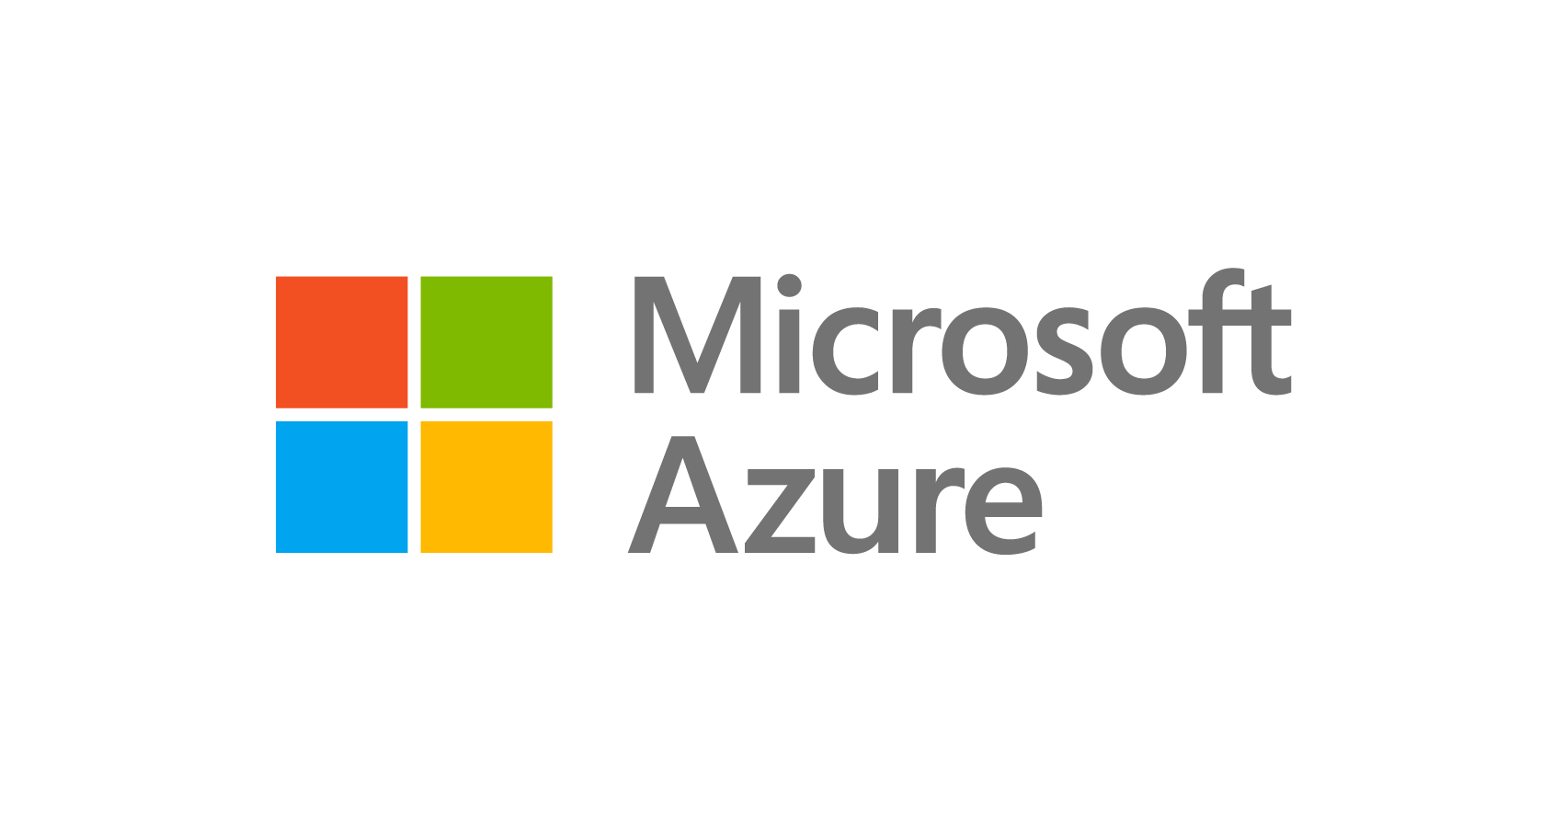

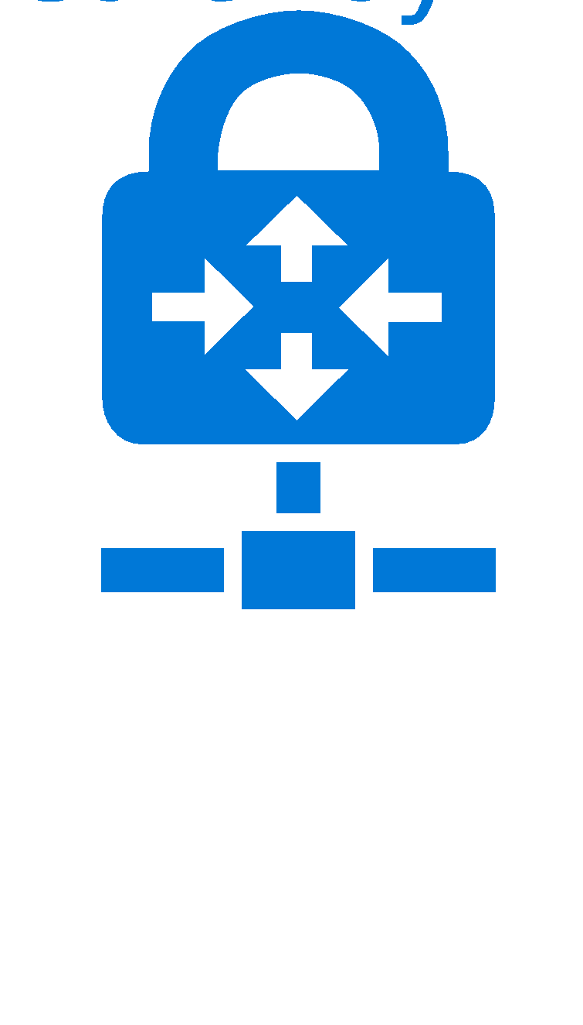




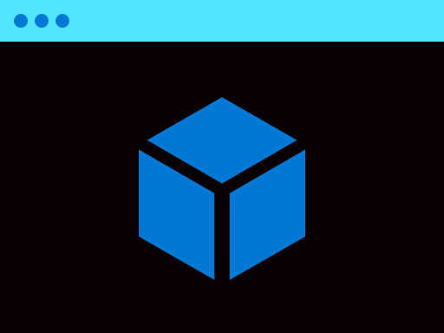


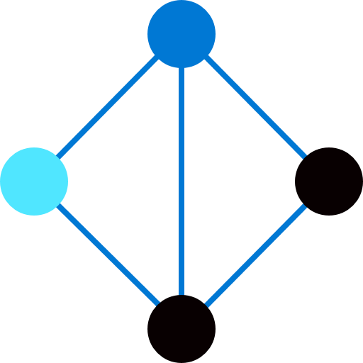



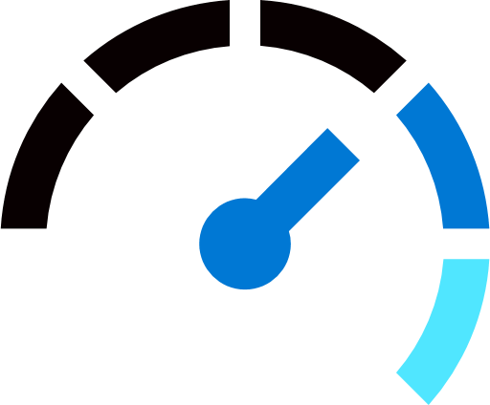



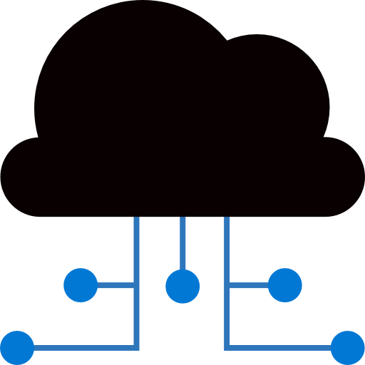



1. Skytap on Azure – Skytap to VNet using VNet ER Gateway
Scenario | Skytap Integrated ExR Circuit | Customer ExR Circuit
1. Skytap SDN <-> Azure VNet using VNet ER Gateway: Same Region | X | X
Customer
Edge Router
Customer Datacenter
Express Route
Azure VNET
Azure Subscription(s)
Skytap Network
Azure Services
Azure Region
Notes:
Most Skytap Demos are configured this way

Slide 5
2. Skytap on Azure – Skytap to VNet using VNet ER Gateway
Scenario | Skytap Integrated ExR Circuit | Customer ExR Circuit
2. Skytap SDN <-> Azure VNet using VNet ER Gateway: Different Region/Same Geopolitical Region | X | X
Customer
Edge Router
Customer Datacenter
Express Route
Azure VNET
Skytap Network
Azure VNET
Azure Subscription(s)
Azure Region
Azure Services
Azure Region

Slide 6
3. Skytap on Azure – Skytap to VNet using VNet ER Gateway
Scenario | Skytap Integrated ExR Circuit | Customer ExR Circuit
3. Skytap SDN <-> Azure VNet using VNet ER Gateway: Different Region/Different Geopolitical Region |  | X
Customer
Edge Router
Customer Datacenter
Express Route Premium SKU
Azure VNET
Skytap Network
Azure VNET
Azure Subscription(s)
Azure Region
Azure Services
Azure Region

Slide 7
4. Skytap on Azure – On Prem to Skytap using Global Reach
Scenario | Skytap Integrated ExR Circuit | Customer ExR Circuit
4. Skytap SDN <-> On-Premises |  | X
Customer
Edge Router
Customer Datacenter
Express Route
Global Reach
Express Route
Global Reach
Azure Subscription(s)
Skytap Network
Azure Region
Notes:
This is how most brand-new SoA customers are configured
Dylan! Additional patterns there.
Changing BGP Peering on Prod Circuit for POC
Prod+POC Mix is an issue, AND,
Existing ER circuit, high bandwidth, add Global Reach? V. EXpensive
=> Add a new lower bandwidth on-prem to Az virtual circuit over the existing physical line.
Global Reach from SKytap to OnPrem; any security controls (firewalls, etc) in Azure are bypassed.
vWAN pattern!

Slide 8
5. Skytap on Azure – Skytap and OnPrem to Vnet, and each other
Scenario | Skytap Integrated ExR Circuit | Customer ExR Circuit
5. Skytap SDN <-> OnPrem + Skytap SDN <-> Azure VNet (All Same Region) | X | X
Customer
Edge Router
Customer Datacenter
Express Route
Global Reach
Express Route
Express Route
Global Reach
Express Route
Azure VNET
Azure Subscription(s)
Skytap Network
Azure Services
Azure Region

Slide 9
6. Skytap on Azure – On Prem + AVS to Skytap using Global Reach
Scenario | Skytap Integrated ExR Circuit | Customer ExR Circuit
6. Skytap SDN <-> Az Dedicated + On-Prem: Same Region |  | X
Customer
Edge Router
Customer Datacenter
Express Route
Global Reach
Express Route
Global Reach
Express Route
Global Reach
Azure Dedicated SoA, AVS, etc
Skytap Network
Azure Subscription(s)
Azure Region
Notes:
Prudential!

Slide 10
7. Skytap on Azure – On Prem + AVS to Skytap using Global Reach
Scenario | Skytap Integrated ExR Circuit | Customer ExR Circuit
7. Skytap SDN <-> Az Dedicated + On-Prem: Different Region/Different Geopolitical Region |  | X
Customer
Edge Router
Customer Datacenter
Express Route Premium
Global Reach
Express Route Premium
Global Reach
Express Route Premium
Global Reach
Azure Dedicated SoA, AVS, etc
Skytap Network
Azure Subscription(s)
Azure Region
Azure Region

Slide 11
End Slide

Slide 12
Appendix
The following slides include the MSEE, which increases their visual complexity, but also their technical accuracy.

Slide 13
1. Skytap on Azure – Skytap to VNet using VNet ER Gateway
Scenario | Skytap Integrated ExR Circuit | Customer ExR Circuit
1. Skytap SDN <-> Azure VNet using VNet ER Gateway: Same Region | X | X
Customer
Edge Router
Customer Datacenter
Microsoft Dedicated Enterprise
Edge routers (D-MSEE)
Express Route
Azure VNET
Azure Subscription(s)
Skytap Network
Azure Services
Azure Region
Notes:
Most Skytap Demos are configured this way

Slide 14
2. Skytap on Azure – Skytap to VNet using VNet ER Gateway
Scenario | Skytap Integrated ExR Circuit | Customer ExR Circuit
2. Skytap SDN <-> Azure VNet using VNet ER Gateway: Different Region/Same Geopolitical Region | X | X
Customer
Edge Router
Customer Datacenter
Microsoft Dedicated Enterprise
Edge routers (D-MSEE)
Express Route
Azure VNET
Azure VNET
Azure Subscription(s)
Skytap Network
Azure Region
Azure Services
Azure Region

Slide 15
3. Skytap on Azure – Skytap to VNet using VNet ER Gateway
Scenario | Skytap Integrated ExR Circuit | Customer ExR Circuit
3. Skytap SDN <-> Azure VNet using VNet ER Gateway: Different Region/Different Geopolitical Region |  | X
Customer
Edge Router
Customer Datacenter
Microsoft Dedicated Enterprise
Edge routers (D-MSEE)
ExpressRoute Premium SKU
Azure VNET
Azure VNET
Azure Subscription(s)
Skytap Network
Azure Region
Azure Services
Azure Region

Slide 16
4. Skytap on Azure – On Prem to Skytap using Global Reach
Scenario | Skytap Integrated ExR Circuit | Customer ExR Circuit
4. Skytap SDN <-> On-Premises |  | X
Customer
Edge Router
Customer Datacenter
Express Route
Global Reach
Express Route
Global Reach
Microsoft Enterprise
Edge routers (MSEE)
Microsoft Dedicated Enterprise
Edge routers (D-MSEE)
Express Route
Global Reach
Azure Subscription(s)
Skytap Network
Azure Region
Notes:
This is how most brand-new SoA customers are configured

Slide 17
5. Skytap on Azure – Skytap and OnPrem to Vnet, and each other
Scenario | Skytap Integrated ExR Circuit | Customer ExR Circuit
5. Skytap SDN <-> OnPrem + Skytap SDN <-> Azure VNet (All Same Region) |  | X
Customer
Edge Router
Customer Datacenter
Global Reach
Express Route
Express Route
Global Reach
Microsoft Enterprise
Edge routers (MSEE)
Microsoft Dedicated Enterprise
Edge routers (D-MSEE)
Global Reach
Express Route
Microsoft Dedicated Enterprise
Edge routers (D-MSEE)
Azure VNET
Azure Subscription(s)
Skytap Network
Azure Services
Azure Region

Slide 18
6. Skytap on Azure – On Prem + AVS to Skytap using Global Reach
Scenario | Skytap Integrated ExR Circuit | Customer ExR Circuit
6. Skytap SDN <-> Az Dedicated + On-Prem: Same Region |  | X
Customer
Edge Router
Customer Datacenter
Express Route
Global Reach
Express Route
Global Reach
Microsoft Enterprise
Edge routers (MSEE)
Microsoft Dedicated Enterprise
Edge routers (D-MSEE)
Express Route
Global Reach
Microsoft Enterprise
Edge routers (MSEE)
Azure Dedicated SoA, AVS, etc
Skytap Network
Azure Subscription(s)
Azure Region
Notes:
Prudential!

Slide 19
7. Skytap on Azure – On Prem + AVS to Skytap using Global Reach
Scenario | Skytap Integrated ExR Circuit | Customer ExR Circuit
7. Skytap SDN <-> Az Dedicated + On-Prem: Different Region/Different Geopolitical Region |  | X
Customer
Edge Router
Customer Datacenter
ExpressRoute Premium
Global Reach
Microsoft Enterprise
Edge routers (MSEE)
ExpressRoute Premium
Global Reach
Microsoft Dedicated Enterprise
Edge routers (D-MSEE)
Microsoft Enterprise
Edge routers (MSEE)
Azure Dedicated SoA, AVS, etc
Skytap Network
Azure Subscription(s)
Azure Region
Azure Region

